Slide 1
Leveraging the Microsoft Graph API from the SharePoint Framework
Extending SharePoint with information from the Microsoft Graph

Slide 2

Microsoft Graph and Azure AD
Intro to the Microsoft Graph
Securing and Accessing the Microsoft Graph
Resources

Slide 3
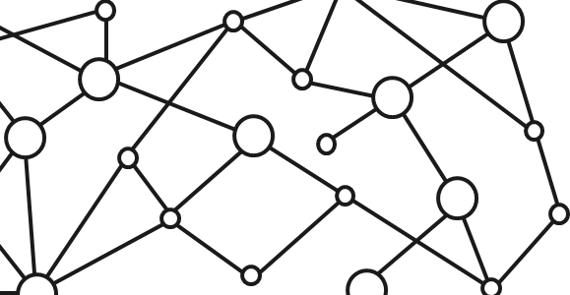
Microsoft 365 Platform
Extend Microsoft 365 experiences
web, device, and service apps
Build your experience
Documents
Pages
Conversations
Timeline
iOS/Android/Windows/Web
1
Microsoft Graph
Notes:
Our Office 365 developer vision focuses on the Users’ experience and their data. As a developer you can bring your applications into their user experience. With over 1.2+ billion users of Office Worldwide, this is a huge opportunity to provide a window into your applications. As well as being able to connect into their data and add intelligence to your applications. There are currently 850 million events created a month and a total of 470Pb+ of data stored in the service that can add value to for our Users’.

Slide 4
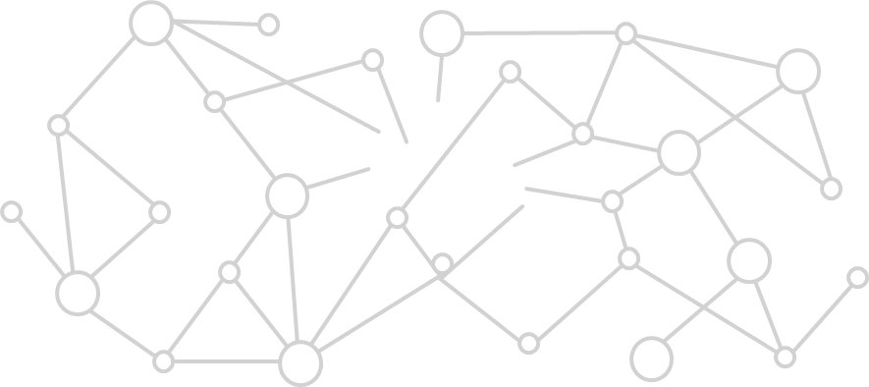
Microsoft Graph Gateway to your data in the Microsoft-cloud
https://graph.microsoft.com
Office 365
Windows 10
Enterprise Mobility + Security
Users, Groups, Organizations
Outlook
SharePoint
OneDrive
Teams
Planner
Excel
OneNote
Activities
Device Relay
Commands
Notifications
Azure AD
Intune
Identity Manager
Advanced Threat Analytics
Advanced Threat Protection
Mail, Calendar,
Contacts and Tasks
Sites and Lists
Drives and Files
Channels, Messages
Tasks and Plans
Spreadsheets
Notes, and more…
Identity Management
Access Control
Synchronization
Domains
Administrative Units
Applications and Devices
Advanced Threat Analytics
Advanced Threat Protection
Alerts
Policies
and more…

Slide 5
Microsoft Graph, gateway to Office 365
Single resource that proxies multiple Microsoft services
Allows for easy traversal of objects and relationships
Simplifies token acquisition and management
Eliminates the need to traditional discovery (using “me” and “myorganization”)

Slide 6
Office 365 direct API Endpoints
Direct API endpoints for all the Office 365 Services may also be invoked
Outlook, OneDrive, OneNote, etc.
Direct endpoints have new functionality before it is exposed via the Graph API
Examples:
Outlook web hooks
Time zone on calendar

Slide 7
Accessing the Microsoft Graph
Direct REST API
Any platform
Any language
Any framework
Native SDKs
Utilize framework & platform specific implementations
Abstracts the details of constructing & processing REST requests over HTTP
.NET, iOS, Android, PhP, Ruby, JavaScript, etc.

Slide 8
Azure AD Applications: The Microsoft Graph Dependency
All Microsoft Graph access options (REST API / SDKs) depend on Azure AD
Must register an Azure AD application to access the Microsoft Graph
Use the Azure AD application to authenticate, gain authorization & obtain an access token
Access token included in the underlying HTTP request to call the Microsoft Graph endpoint

Slide 9
Single authentication flow for Office 365
Sign users in using OpenID Connect
Azure AD and Office 365 services
Supports MFA and federated user sign-in
Device apps, web sites, SPAs, and service apps
Pin apps to Office 365 app launcher from My apps

Slide 10
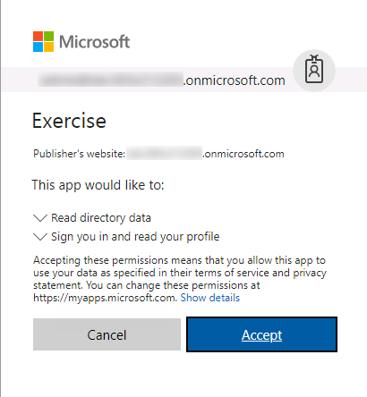
Common consent
Single auth flow for accessing all O365 services
Admin and end-user consent
Secure protocol
OpenID Connect and OAuth 2.0
No capturing user credentials
Fine-grained access scopes
Long-term access through refresh tokens

Slide 11
Authentication Options
Azure AD only
Separate auth flow supports Azure AD accounts only
Azure AD and Microsoft Accounts
Converged auth flow supports Azure AD accounts and Microsoft accounts (LiveID - hotmail.com, etc.)

Slide 12
Microsoft Account + Azure AD
Many apps want to sign users in from both Microsoft account and Azure AD
Single endpoint, OpenID Connect and OAuth 2.0
Single SDK
Single end user sign in experience
Single app registration experience
Works with Microsoft Graph
Single API endpoint, business and consumer data

Slide 13
Accessing the Microsoft Graph from the SharePoint Framework

Slide 14
Office 365 and SharePoint Online Users Already Authenticated
Users in Office 365 are already authenticated
SharePoint Online & Office 365 share the same Azure AD dependency as Microsoft Graph
Users login to Office 365 with their Work & School account (Azure AD)
Calls to the Microsoft Graph are proxied through SharePoint Online
Eliminates the need for creation of a separate Azure AD application
Does not bypass any permission / scope requirements
Can only access business entities, not consumer entities

Slide 15
Demo Accessing User Details from the Microsoft Graph in a SharePoint Framework Client-Side Web Part

Slide 16

Summary
The Microsoft Graph REST API enables any application using any language on any platform to access organization data provided they have appropriate permissions
Azure AD is the single dependency shared between both the Microsoft Graph and Office 365’s SharePoint Online
SharePoint can simplify the authentication process to access the Microsoft Graph as users are already logged into Azure AD

Slide 17
Reading further
Microsoft Graph
https://developer.microsoft.com/graph
Graph Explorer
https://developer.microsoft.com/graph/graph-explorer
Microsoft Graph JavaScript SDK
https://github.com/microsoftgraph/msgraph-sdk-javascript

Slide 18
Thank you.

